Slide 1


Proposition 65
Safe Drinking Water and Toxic Enforcement Act of 1986
PRESENTATION CREATED MARCH 2023
Notes:
With a focus on Environmental Justice and the most beneficial aspects of this proposition for EJ communities
Key Q: how do you research if a company already published a notice?/how do you find out if they published? Email oehha
Ex. lennar
A: (?) 60-Day Notice Search | State of California - Department of Justice - Office of the Attorney General

Slide 2
More specifically...
Safe Drinking Water and Toxic Enforcement Act of 1986
1
Prop 65 prohibits businesses from knowingly discharging listed substances into drinking water sources, or onto land where the substances can pass into drinking water sources.
2
Prop 65 prohibits businesses from knowingly exposing individuals to listed substances without providing a clear and reasonable warning.
Notes:
Safe Drinking Water and Toxic Enforcement Act of 1986, with a focus on the latter

Slide 3

What’s our focus?
Proposition 65 requires businesses to provide “clear and reasonable” warnings to Californians about significant exposures to chemicals that cause cancer, birth defects, or other reproductive harm.
This information benefits those whose work involved Environmental Justice and Health Justice because these warnings have reduced chemical exposures for consumers and the proposition can be used as a tool to force proper warning labels for specific contaminants .
Notes:
Also known as the Safe Drinking Water and Toxic Enforcement Act of 1986 compiles a list of chemicals that cause cancer, birth defects or other reproductive harm requires businesses to provide warnings to about significant exposures to listed chemicals as well as never knowingly discharging significant amounts of listed chemicals into sources of drinking water.
In 1986, California voters approved an initiative to address their growing concerns about exposure to toxic chemicals.

Slide 4
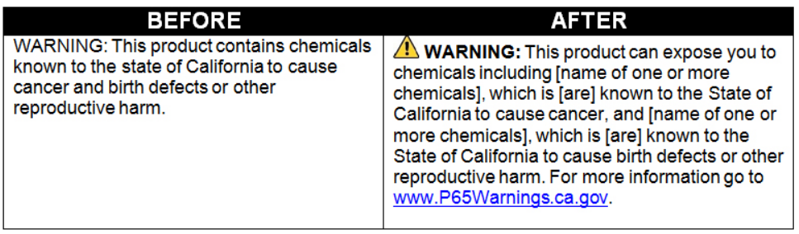
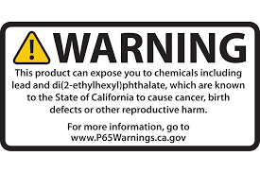
Warning Signs
Warnings can be provided in a number of ways
labeling a consumer product
posting signs at the workplace
distributing notices at a rental housing complex
displaying notices on a building’s wall (inside or outside)
at checkout in stores
listed in the details of an online product
Warnings must be provided one year after a chemical is added to the list
Notes:
Sources
Frequently Asked Questions for Businesses - Proposition 65 Warnings Website

Slide 5
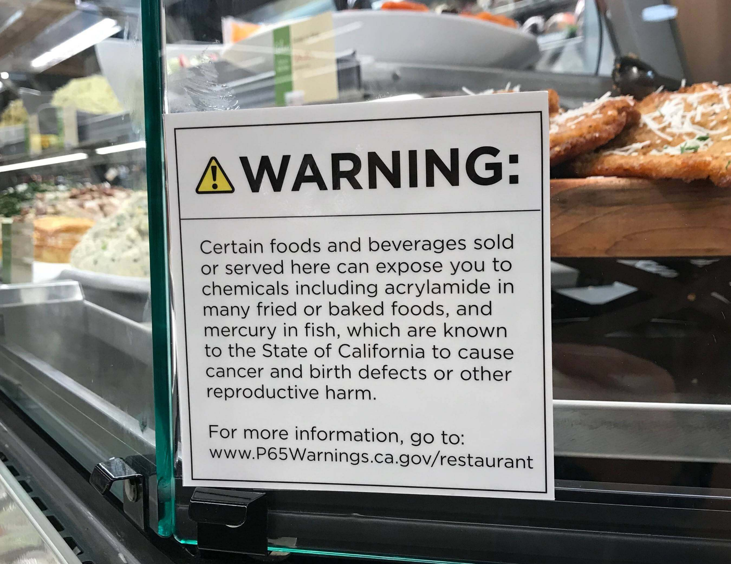
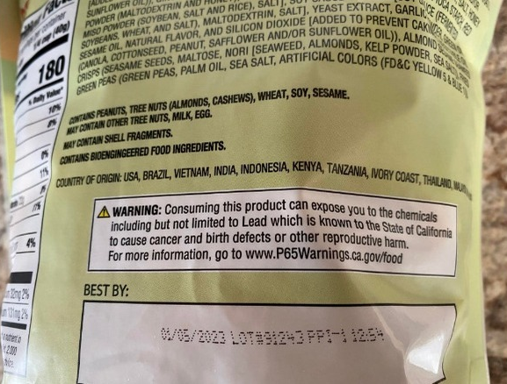
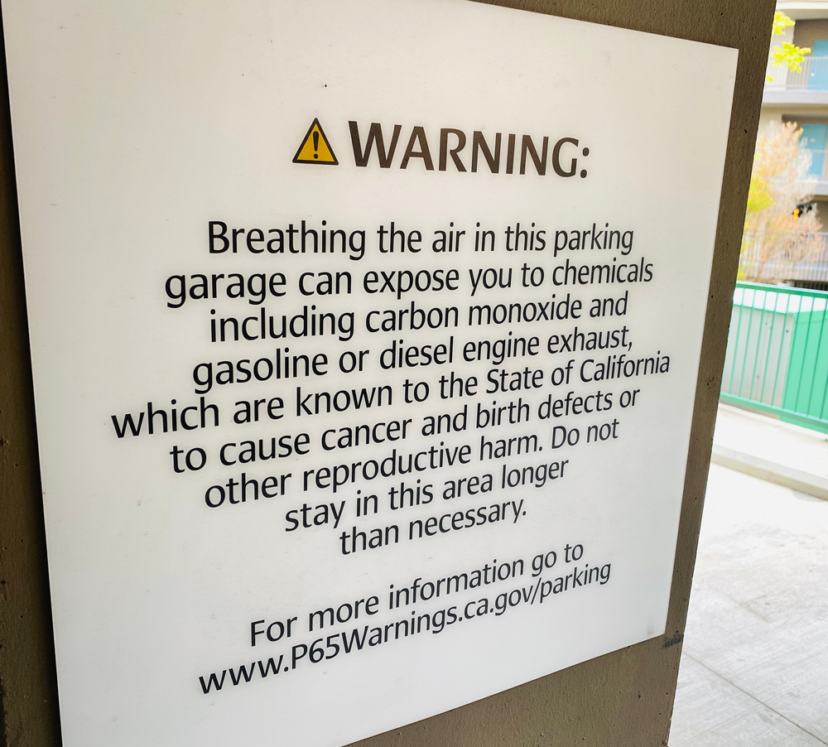
Prop 65 Warning posted on a hot food bar Image source
Prop 65 Warning on the back of a Costco ‘Bento Box Snack Mix’ Image source
Prop 65 Warning posted in a parking garage Image Source
Examples
Notes:
Plants can even have warnings because of wood dust and crystalline silica from perlite, both of which could be in the soil
*Prop 65 does not stop the creation, use, or exposure of any listed chemicals. The proposition only requires businesses to warn people in California that they may be exposed to a listed chemical.

Slide 6
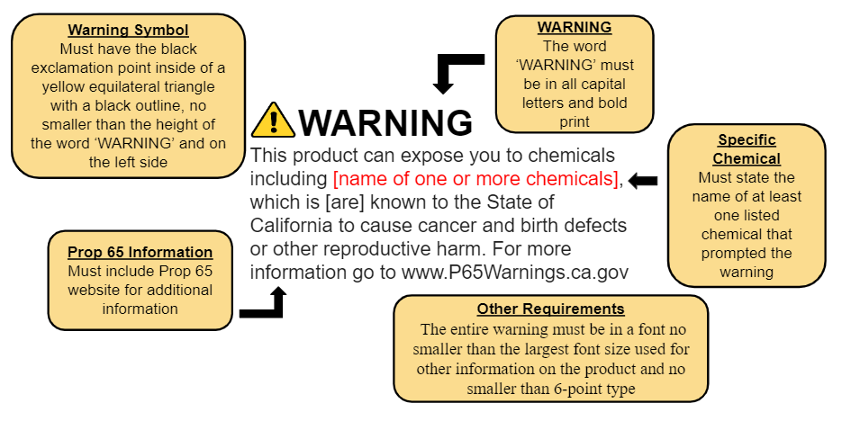

Slide 7
What are these warnings for?
Proposition 65 list contains two types of chemicals:
Carcinogens (can cause cancer)
Reproductive toxicants (cause birth defects or other reproductive harm, such as sterility or miscarriages)
This proposition has moved businesses away from using chemicals on the Prop 65 list in order to avoid labeling their product or space with a warning label.
And according to the EPA: Proposition 65 has “increased public awareness about the adverse effects of exposures to listed chemicals.... [and] provided an incentive for manufacturers to remove listed chemicals from their products.”
Notes:
Proposition 65- Protecting California and the Nation from Toxic Chemicals - Center for Environmental Health
Examples:
Because of Prop 65 legal work shampoos no longer contain cancer-causing chemical Cocamide DE
Lead-containing bibs were sold at Walmart and Babies-R-Us and Prop 65 was used to get legal agreements with both companies to eliminate hazardous lead

Slide 8
Exemptions:
Governmental agencies and public water utilities
Businesses with 9 or fewer employees
Exposures that pose no significant risk of cancer or reproductive harm
Exposures that will produce no observable reproductive effect at 1,000 times the level in question
No Significant Risk Level (NSRL)
a level of exposure that would cause no more than 1 extra case of cancer in 100,000 people over a 70 year lifetime
Notes:
Governmental agencies and public water utilities: All federal, state and local government agencies, as well as entities operating public water systems, are exempt.
The law defines "no significant risk" as a level of exposure that would cause no more than 1 extra case of cancer in 100,000 people over a 70 year lifetime.
Discharges that do not result in a "significant amount" of the listed chemical entering any source of drinking water

Slide 9

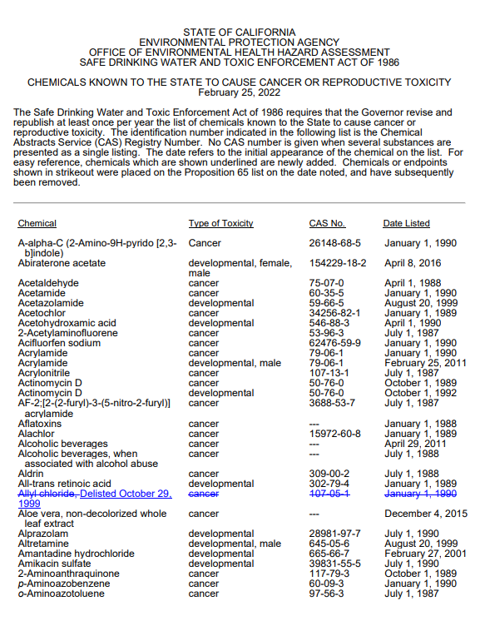
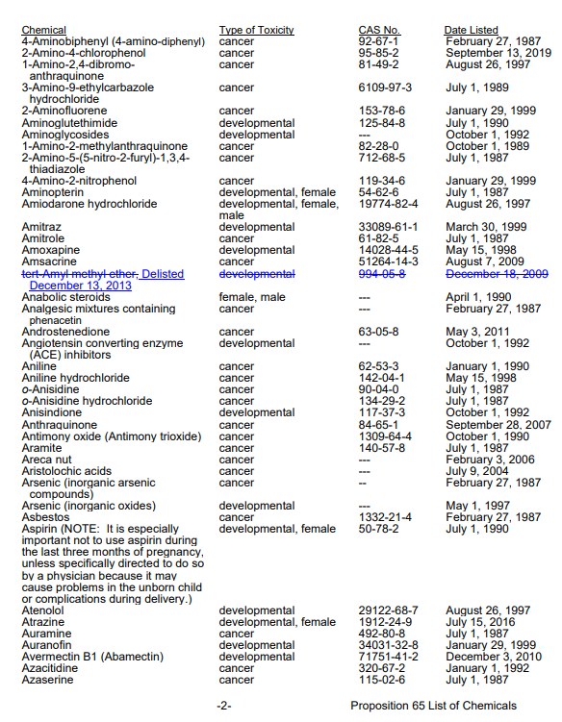
Who oversees Proposition 65?
The Office of Environmental Health Hazard Assessment (OEHHA) lists chemicals, and the California Attorney General’s office or any district attorney or certain city attorneys, or by any individual acting in the public interest can enforce Proposition 65.
Notes:
Link to Prop 65 chemicals hyperlinked
Pages 1&2 of 23 are shown of the OEHHA
Proposition 65 requires the State to publish a list of chemicals known to cause cancer or birth defects or other reproductive harm. This list, which must be updated at least once a year, has grown to include over 800 chemicals since it was first published in 1987

Slide 10
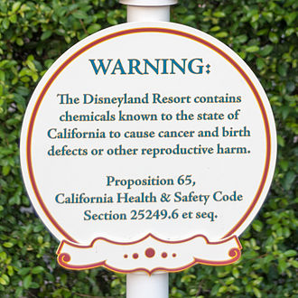
Critiques of Prop 65
No penalty for overuse
White noise effect
People may come to ignore the warnings
Questions as to how often consumers’ choices are actually influenced
Vagueness
Lack of specific chemical information
Fear provoking

Slide 11
Prop 65 blind spots
Prop 65 labels only states that a product “can expose you to chemicals including…”
They may not list all substances, where it is in the product, how you might be exposed to it, how much of the substance, what the level of risk is, or how to reduce your exposure.
The OEHHA doesn't offer information to help consumers figure out what the potential risk is and how to avoid it. These kinds of details can only come from the product’s manufacturer and that information can be difficult to obtain.
Notes:
In a 2014 Property and Environment Research Center (PERC) study, cancer rates in California have not fallen significantly since Prop 65 took place compared to other states. Little to no statistical support was found that Prop 65 significantly influenced cancer rates in California. Lack of available data didn't allow for similar examination of the law's effect on reproductive health.

Slide 12
What is a Prop 65 Violation?
A Prop 65 violation is when a business’s product or activity could expose people in California to any of the 900+ listed chemicals classified as carcinogenic and/or could cause reproductive harm and there is no clear and reasonable warning.
Businesses must label their products with a “clear and reasonable” warning if it contains or may expose consumers to any of the listed Proposition 65 chemicals.
Businesses include:
[but not limited to]
Retail
Food and Beverage
Housing units
Amusement Parks
Medical facilities
Construction sites
Other facilities that may expose you to a listed chemical
Notes:
Specific to the ‘toxic enforcement’ aspect of the Act

Slide 13

Enforcement
Enforcement is carried out through civil lawsuits against Proposition 65 violators.
These lawsuits may be brought by the California Attorney General, any district attorney, or certain city attorneys (those in cities with a population over 750,000).
Lawsuits may also be brought by private parties "acting in the public interest," but only after providing notice of the alleged violation to the Attorney General, the appropriate district attorney and city attorney, and the business accused of the violation.

Slide 14
How to identify a Prop 65 violation
Steps to take once you suspect a prop 65 violation:
Send the product or a sample from exposure site to a lab for testing
Write a “certificate of merit”
File the 60-day notice online
Wait to hear back from the attorney general if lawsuit will be filed
If filed, follow through with legal process
Prop 65 violations can be difficult to identify but there are key aspects to look out for
Construction or development exposing residents to dust and PM that contains a Prop 65 chemical(s)
A chemical exposure from a known source that does not provide a warning

Slide 15
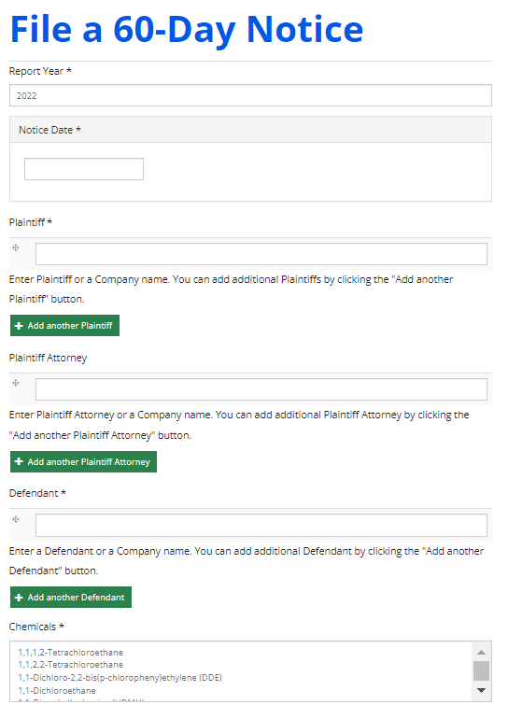
60-Day Notices
File a Notice of Violation online
A Proposition 65 Notice of Violation must provide adequate information to allow the OAG to assess the nature of the alleged violation.
Private enforcers must also serve a certificate of merit which is a statement of expert consultation(s) supporting belief of reasonable and worthwhile private action
File a 60-Day Notice | State of California - Department of Justice - Office of the Attorney General
Notes:
https://leginfo.legislature.ca.gov/faces/codes_displaySection.xhtml?sectionNum=25249.7&lawCode=HSC
https://www.intertek.com/consumer/insight-bulletins/prop-65-60-day-notices-analysis-03-2022/
A notice must comply with the information and procedural requirements specified in regulations. A private party may not pursue an enforcement action directly under Proposition 65 if one of the government officials noted above initiates an action within sixty days of the notice.
A member of the public can directly contact AG or through an attorney.

Slide 16
Aspects to Consider
Time consuming
Requires professional assistance
Can result in high cost
Only sometimes are fees reimbursed when/if case is won
Claims are highly technical
Prop 65 cannot stop the use of any chemical or lessen exposure, it only requires a clear and reasonable warning
Even when in some cases it has halted the use of a chemical, this is in no way guaranteed
Filing a Proposition 65 claim takes time and money

Slide 17
Thank you for your time and attention!
Questions or Comments?
For follow up questions, a copy of the slide deck, or comments
please reach out to skylar@greenaction.org

